Slide 1
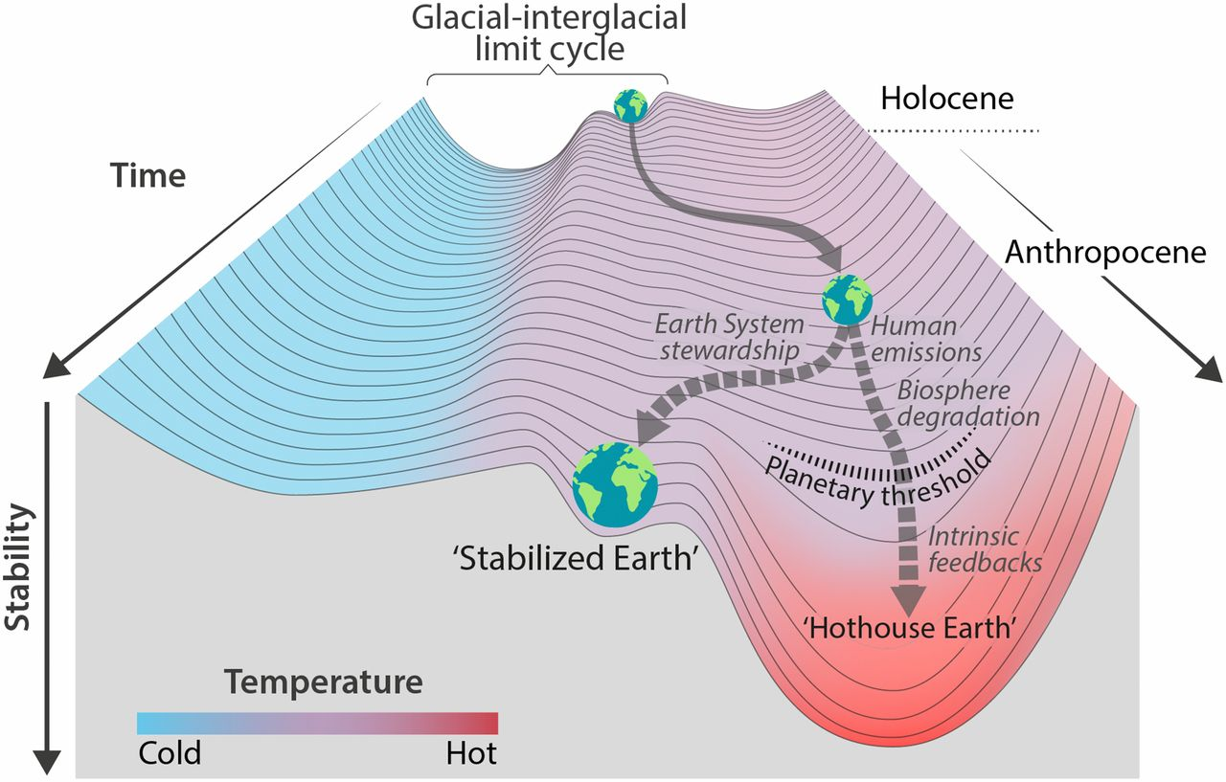
A strategy of “Earth System Stewardship” can be formulated in Hothouse/Icehouse terms
The warmer it gets, the more likely it is that we slip from “Icehouse Earth” into “Hothouse Earth”.
One line of thinking about Earth System stewardship would be to bring us to a “Stabilized Earth” intermediate between them.
To explore this, we need more flexible ways of specifying anthropogenic emissions (ScheduleFlowsLTE).
*
‘Icehouse Earth’
Steffen et al, PNAS 2018: https://www.pnas.org/content/115/33/8252

Slide 2
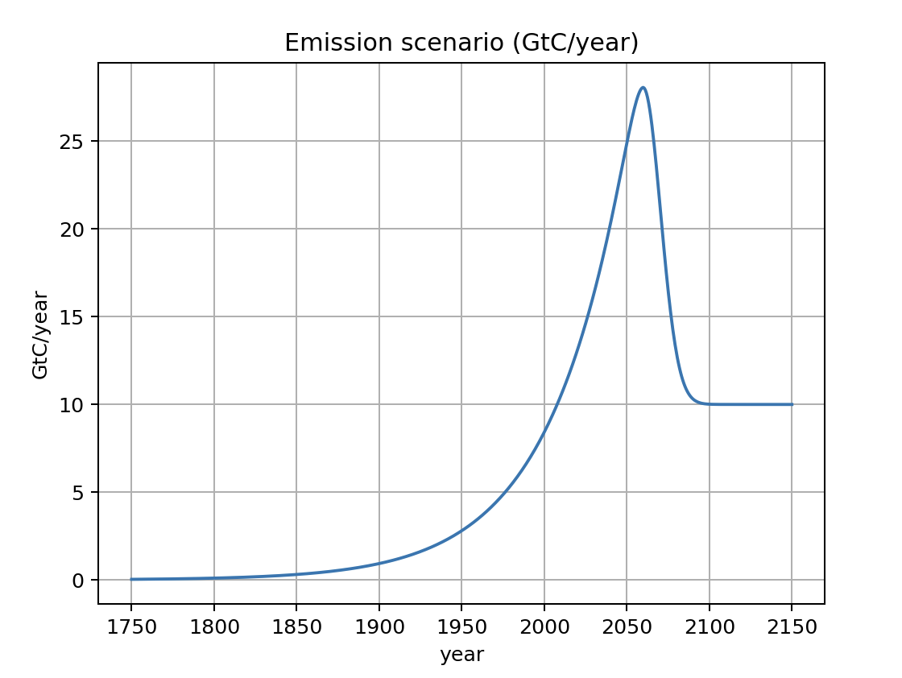
ScheduledFlowsLTE allows for partial decarbonization

Slide 3
A strategy of “Earth System Stewardship” can be formulated in Hothouse/Icehouse terms
We also need to understand better what Hothouse Earth is, and the mechanisms by which Earth switches back and forth between it and Icehouse Earth.
*
‘Icehouse Earth’
Steffen et al, PNAS 2018: https://www.pnas.org/content/115/33/8252

Slide 4
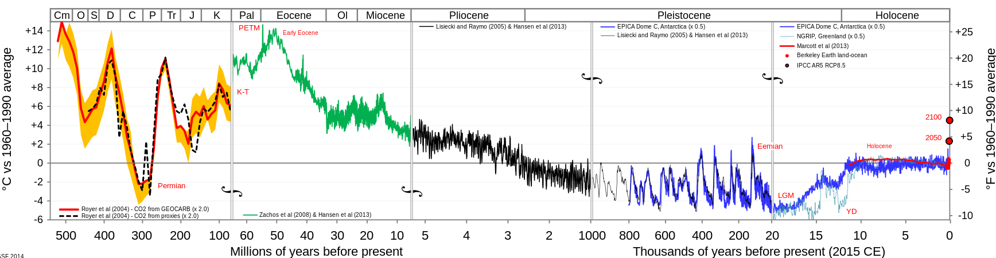
55 million years ago, Hothouse Earth
Past Present
Hothouse Earth
Icehouse Earth

Slide 5
Then, collision of India with Asia
Past Present
Hothouse Earth
Icehouse Earth
Collision video

Slide 6
Basically, “Icehouse Earth” involves the creation of lots of ice on Earth’s surface (cryosphere)
Permanent ice in Greenland forms
Arctic ice persists throughout the summer
Hothouse Earth
Icehouse Earth
Permanent ice forms in the East Antarctic
Northern Hemisphere ice sheets form and disappear. The last disappeared 20,000 years ago (so we don’t have to worry about them)
The West Antarctic Ice Sheet (WAIS) forms and disappears. The last time was during the Eemian (and the Anthropocene is even warmer).

Slide 7
A strategy of “Earth System Stewardship” can be formulated in Hothouse/Icehouse terms
OK, the next challenge is to see how to model these mechanisms
*
‘Icehouse Earth’
Steffen et al, PNAS 2018: https://www.pnas.org/content/115/33/8252

Slide 8
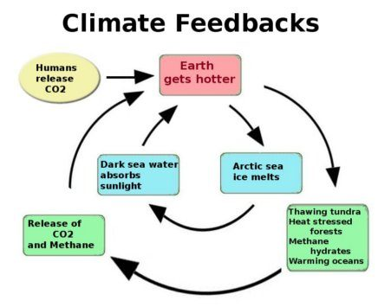
Feedbacks we’ve modeled so far

Slide 9
Feedbacks we’ve touched on so far: The Henry effect (Implemented in Cambio 2.0)

Slide 10
Feedbacks we’ve touched on so far: Ice-albedo (Implemented in IceFreeArctic)

Slide 11
But we still need to incorporate this into our carbon mass balance (Cambio 3.0)

Slide 12
But we still need to incorporate this into our carbon mass balance (Cambio 3.0)

Slide 13
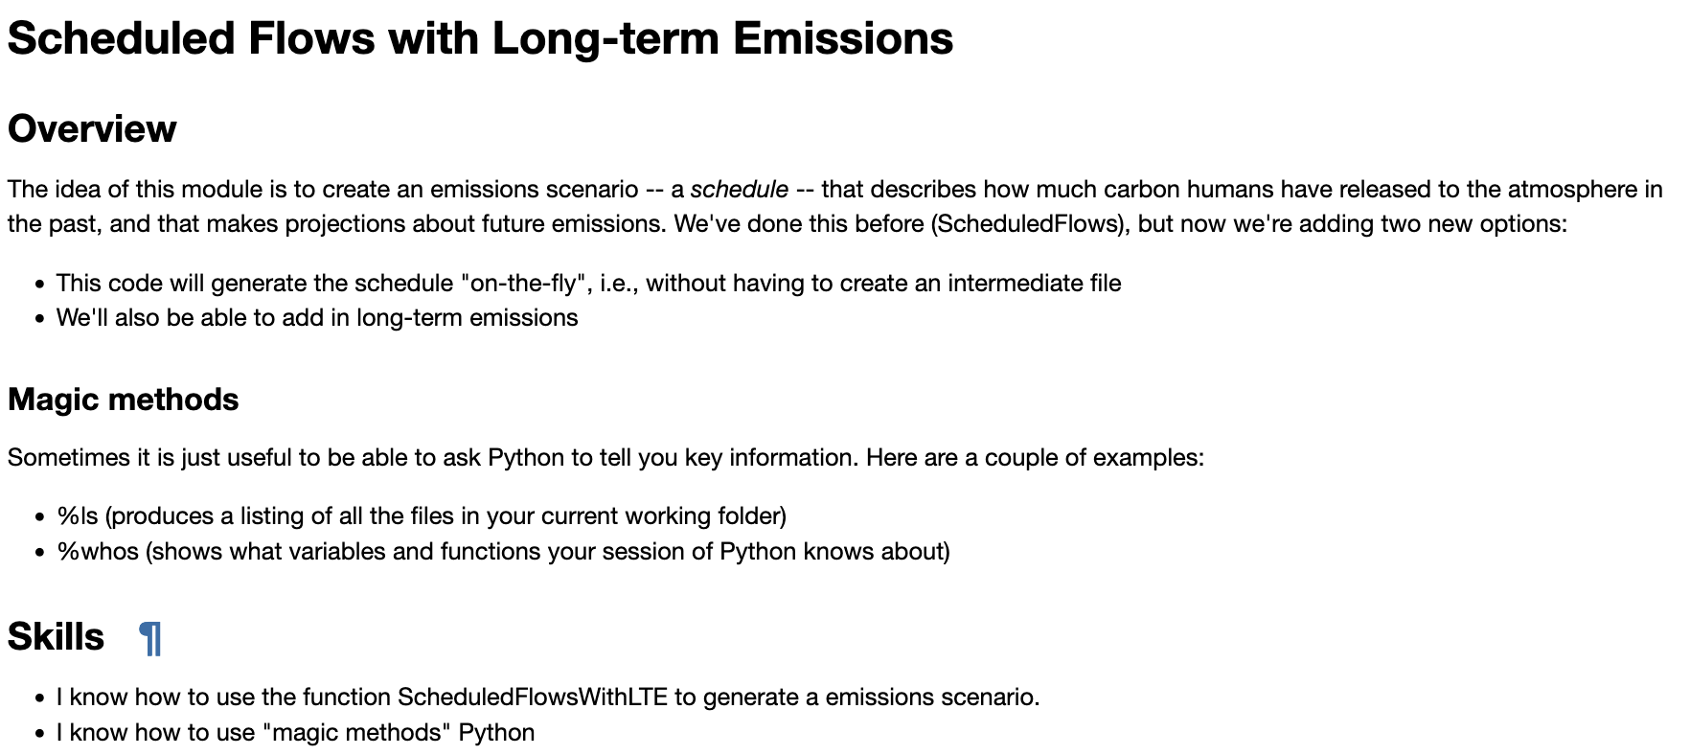
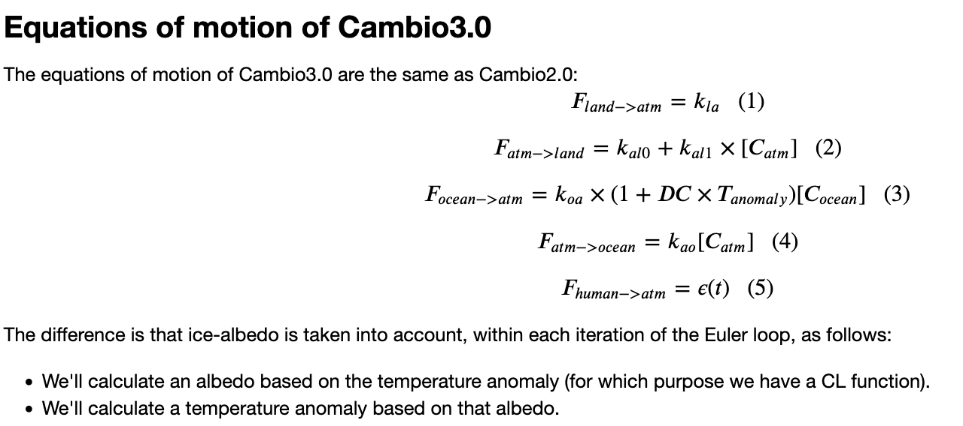
OK, let’s get started

